Slide 1
Chapter 5 Conceptualization, Operationalization, and Measurement

Slide 2
Chapter Outline
Introduction
Measuring Anything That Exists
Conceptualization
Definitions in Descriptive and Explanatory Studies
Operationalization Choices
Criteria of Measurement Quality
The Ethics of Measurement
Chapter Summary
Questions

Slide 3
Measuring Anything That Exists (slide 1 of 2)
Measurement – Careful, deliberate observations of the real world for the purpose of describing objects and events in terms of the attributes composing the variable.
How would you measure…
political party affiliation?
age?
grade point average?
satisfaction with college?
religious affiliation?

Slide 4
Measuring Anything That Exists (slide 2 of 2)
Conceptions, Concepts, and Reality
How would you conceptualize…
prejudice?
compassionate?
Concepts as Constructs
Concepts are constructs derived by mutual agreement from mental images.
Conceptions summarize collections of seemingly related observations and experiences

Slide 5
Conceptualization (slide 1 of 6)
Conceptualization – The process through which we specify what we mean when we use particular terms in research.
We cannot meaningfully answer a question without a working agreement about the meaning of the outcome.
Conceptualization processes a specific agreed-on meaning for a concept for the purposes of research.

Slide 6
Conceptualization (slide 2 of 6)
Indicators and Dimensions
Indicator – An observation that we choose to consider as a reflection of a variable we wish to study.
Dimension – A specifiable grouping of a concept/construct/variable.
Multiple indicators can make up a single dimension (amongst multiple dimensions) of a concept/variable

Slide 7
Conceptualization (slide 3 of 6)
Identify appropriate indicators and dimensions for…
religious affiliation
college success
political activity
poverty
binge drinking
fear of crime

Slide 8
Conceptualization (slide 4 of 6)
The Interchangeability of Indicators
If several different indicators all represent the same concept, all of them will reach the same result.

Slide 9
Conceptualization (slide 5 of 6)
Real, Nominal, and Operational Definitions
Specification – The process through which concepts are made more specific.
A nominal definition is one that is arbitrarily assigned to a concept without any claim that the definition represents the “real” concept.
An operational definition specifies precisely how a concept will be measured – that is, the operations we will perform.

Slide 10
Conceptualization (slide 6 of 6)
Conceptualization – Practice
Anomie

Slide 11
Definitions in Descriptive and Explanatory Studies
Definitions are more problematic for descriptive research than for explanatory research.

Slide 12
Operationalization Choices (slide 1 of 8)
Conceptualization is the refinement and specification of abstract concepts.
Operationalization is the development of specific research procedures that will result in empirical observations representing those concepts in the real world.
Range of Variation
The extent to which you will try to study all aspects of a concept. (normal curve?)

Slide 13
Operationalization Choices (slide 2 of 8)
Variation between the Extremes
To what degree is the operationalization of variables precise?

Slide 14
Operationalization Choices (slide 3 of 8)
Defining Variables and Attributes
An attribute is a characteristic or quality of something (ex: female, old, student).
A variable is a logical set of attributes (ex: gender, age).
Every variable must have two important qualities.
The attributes composing it should be exhaustive.
Attributes must be mutually exclusive.

Slide 15
Operationalization Choices (slide 4 of 8)
Levels of Measurement
Nominal
Ordinal
Interval
Ratio

Slide 16
Operationalization Choices (slide 5 of 8)
Levels of Measurement – Nominal
Variables whose attributes have only the characteristics of exhaustiveness and mutually exclusiveness. Simple categories. Attributes that classify, but cannot be ranked!
Examples: gender, religious affiliation, college major, hair color, birthplace, nationality, party affiliation

Slide 17
Operationalization Choices (slide 6 of 8)
Levels of Measurement – Ordinal
Variables with attributes we can logically rank order. Variables whose attributes that classify and can be ranked but lack an associated numerical value.
Examples: socioeconomic status, level of conflict, prejudice, conservativeness, hardness

Slide 18
Operationalization Choices (slide 7 of 8)
Levels of Measurement – Interval
Variables for which the actual distance between attributes has meaning. Variables whose attributes classify, can be ranked ordered, and have an equal numerical distance between values.
Examples: temperature (Fahrenheit), IQ score

Slide 19
Operationalization Choices (slide 8 of 8)
Levels of Measurement – Ratio
Variables whose attributes meet the requirements of a interval measure, and has a true zero point.
Examples: temperature (Kelvin), age, length of time, number of organizations, number of groups, number of A’s received in college

Slide 20
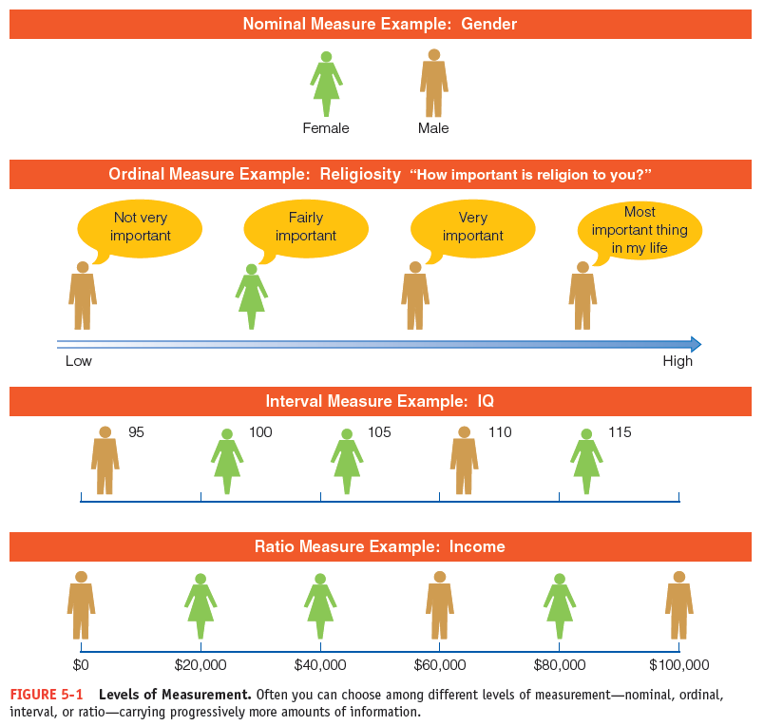
Figure 5-1
Levels of Measurement
Often you can choose among different levels of measurement—nominal, ordinal, interval, or ratio—carrying progressively more amounts of information.

Slide 21
Operationalization Choices (slide 1 of 2)
Implications of Levels of Measurement
Analyses require minimum levels of measurement
Some variables can be treated as multiple levels of measurement
Single or Multiple Indicators

Slide 22
Criteria of Measurement Quality (slide 1 of 4)
Precision and Accuracy
Precise measures are superior to imprecise ones.
Reliability
That quality of measurement method that suggests that the same data/measurements would have been collected each time in repeated observations of the same phenomenon.

Slide 23
Criteria of Measurement Quality (slide 2 of 4)
Test-Retest Method
To make the same measurement more than once.
Split-Half Method
Multiple sets of randomly assigned variables should produce the same classifications
Established Measures
Reliability of Research Workers

Slide 24
Criteria of Measurement Quality (slide 3 of 4)
Validity – a term describing a measure that accurately reflects the concept it is intended to measure.
Face Validity – That quality of an indicator that makes it seem a reasonable measure of some variable.
Criterion-Related Validity – The degree to which a measure related to some external criterion.

Slide 25
Criteria of Measurement Quality (slide 4 of 4)
Construct Validity – The degree to which a measure relates to other variables as expected within a system of theoretical relationships.
Content Validity – The degree to which a measure coves the range of meanings included within a concept.

Slide 26
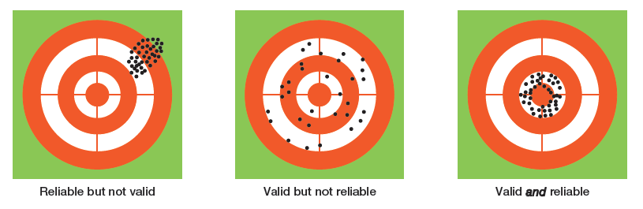
Figure 5-2
An Analogy to Validity and Reliability
A good measurement technique should be both valid (measuring what it is intended to measure) and reliable (yielding a given measurement dependably).

Slide 27
The Ethics of Measurement
Conceptualization and measurement must not be guided by bias or preferences for particular research outcomes

Slide 28
Chapter Summary (slide 1 of 2)
Explain and illustrate how conceptions, concepts, and constructs relate to reality.
Describe the steps involved in the process of conceptualization.
Discuss the assertion that definitions are more critical in descriptive than in explanatory studies.

Slide 29
Chapter Summary (slide 2 of 2)
Identify and illustrate the many choices you may have in operationalizing variables.
Distinguish among precision, accuracy, reliability, and validity and discuss how they affect the quality of a measurement technique.
Explain how measurement decisions can have ethical implications.

